Slide 1
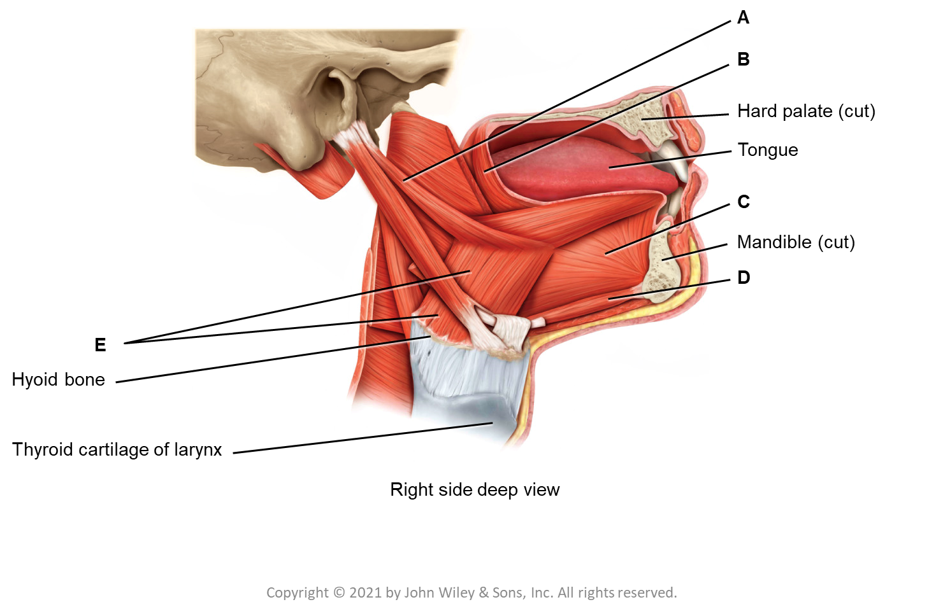
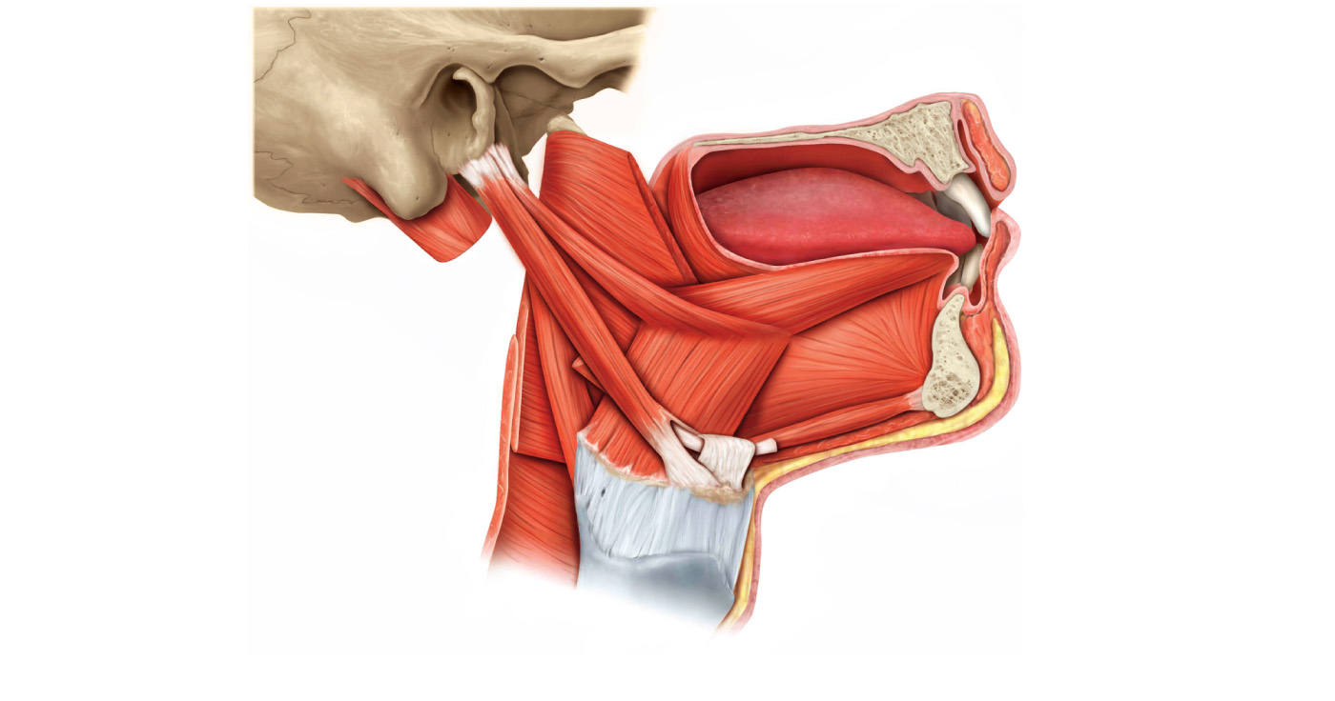
A
B
Hard palate (cut)
Tongue
C
Mandible (cut)
D
E
Hyoid bone
Thyroid cartilage of larynx
Right side deep view

Slide 2
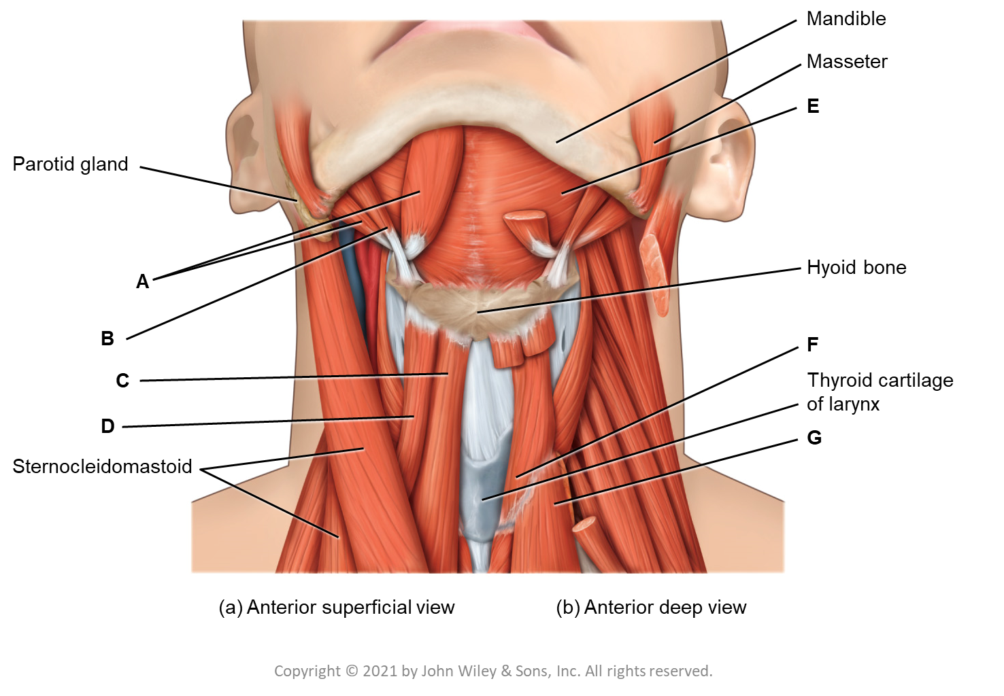
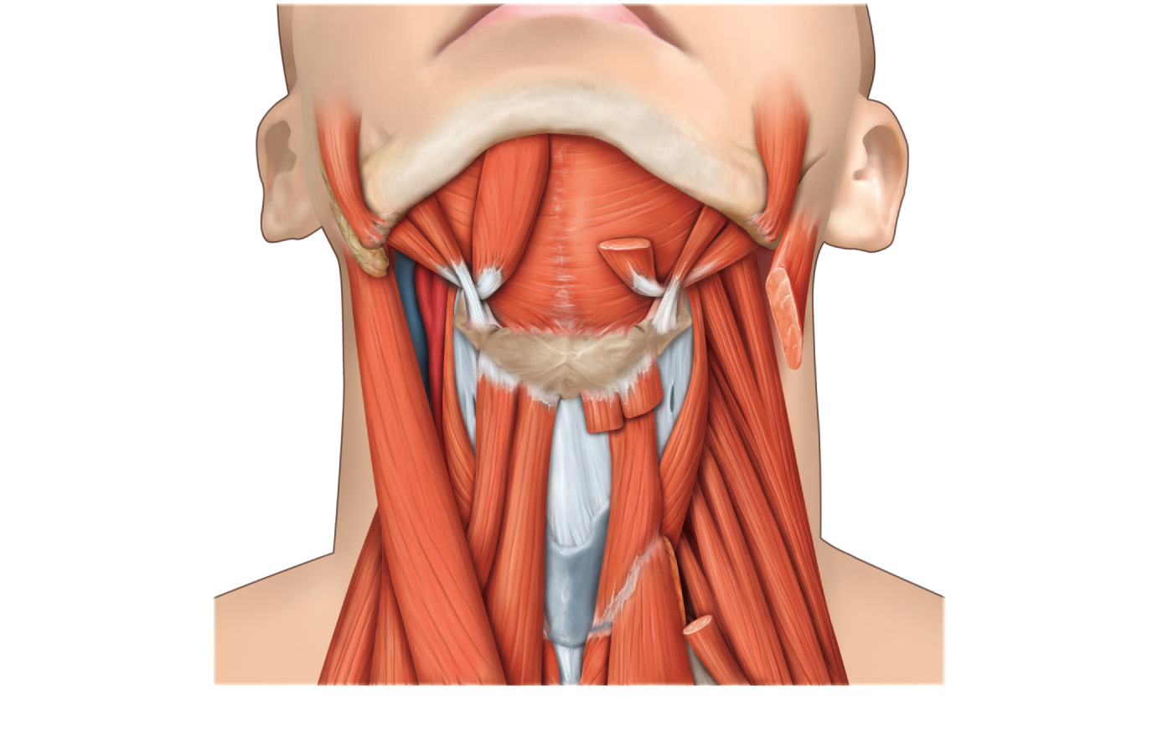
Mandible
Masseter
E
Parotid gland
A
Hyoid bone
B
F
C
Thyroid cartilage
of larynx
D
G
Sternocleidomastoid
(a) Anterior superficial view
(b) Anterior deep view

Slide 3
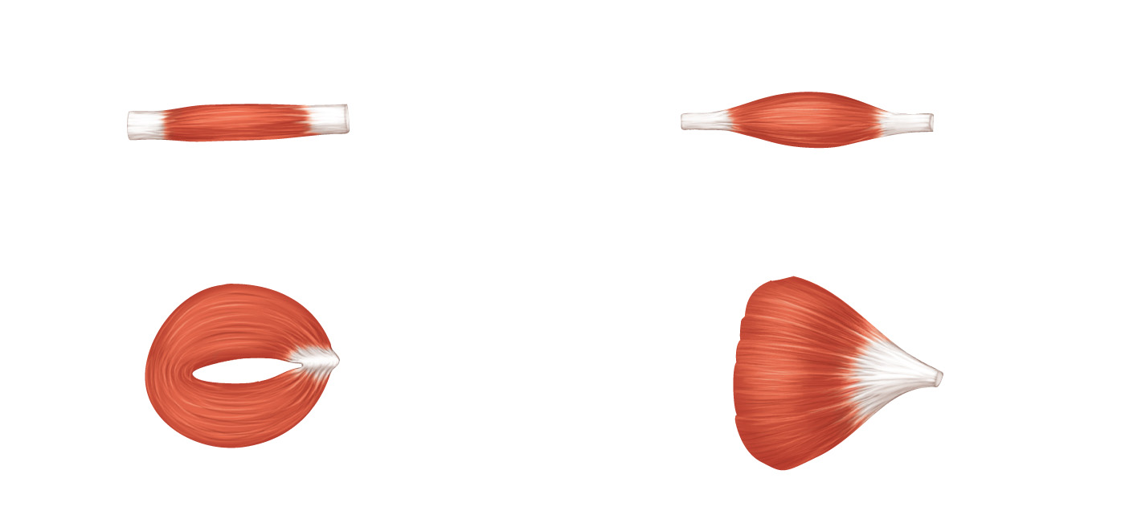
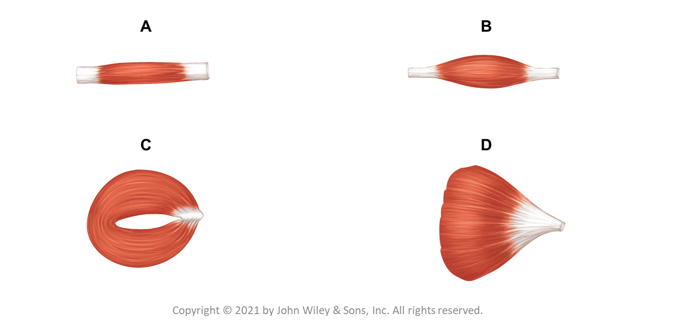
A
B
C
D

